Slide 1
Hotel Data Exploratory Analytics
Presentation by: Roy Gupta, Manager MIS Projects

Slide 2
Things we cover Today?
Data Quality Issues
Dashboard : Analyzing Hotel Revenue by Booking and Food Orders
Actionable Insight 1: Low Revenue Indicator - Doctors and Professionals [PhD, DVM, DDS]
Actionable Insight 2: Low Revenue Indicator - Double Room
Actionable Insight 3: High Revenue Indicator - Normal Room
Actionable Insight 4: High Revenue Indicator - Small Conference Room
Actionable Insight 5: Best Selling Dinner! – Vegetarian Lasagna, Steak and Stuff and Surf n turf
Actionable Insight 6: Best Selling Breakfast! - Deluxe Breakfast
Actionable Insight 7: Low Revenue Indicator - Lunch Menu (Scope of Improvement)
Actionable Insight 8: Low Revenue Indicator – Why most customers order alcohol inside the room?
Appendix 1 : Correlation Matrix
Appendix 2 : Large Conference Room
Appendix 3 : Deluxe Room
Appendix 4 : Drinks Insights (Non Alcoholic)

Slide 3
Data Quality Issues
Multiple Entries with ‘1916’ year founds in Booking Data
Multiple Entries with ‘Double_Room’ in Request Data, creating blank records after joining tables.
High Correlation detected among variables, after joining tables. Refer to Appendix 1
Only 66 Observations for Month 4 on Food Orders Data, Excluded from the overall analysis.

Slide 4
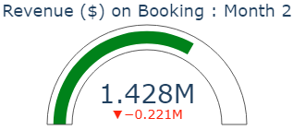
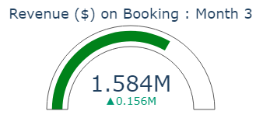
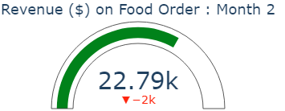
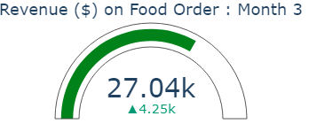
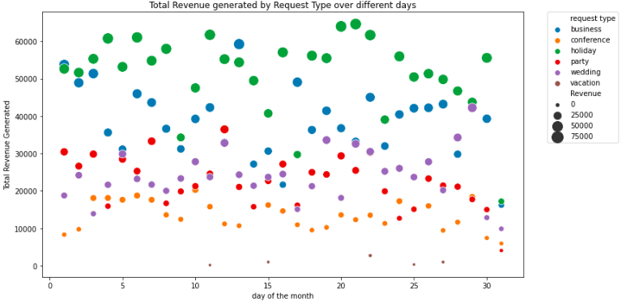
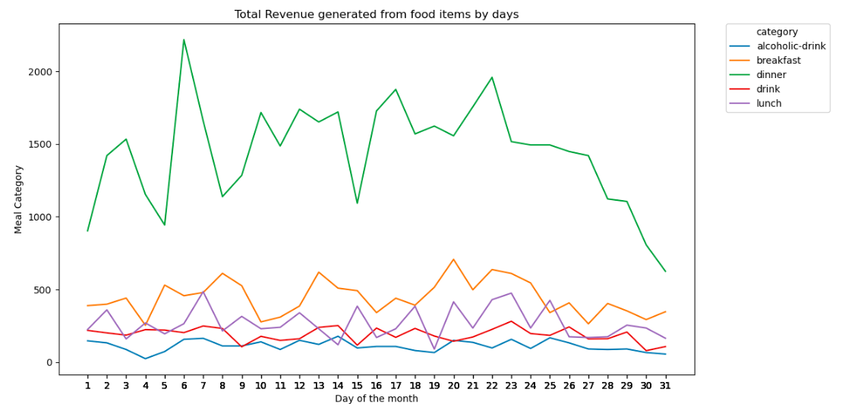
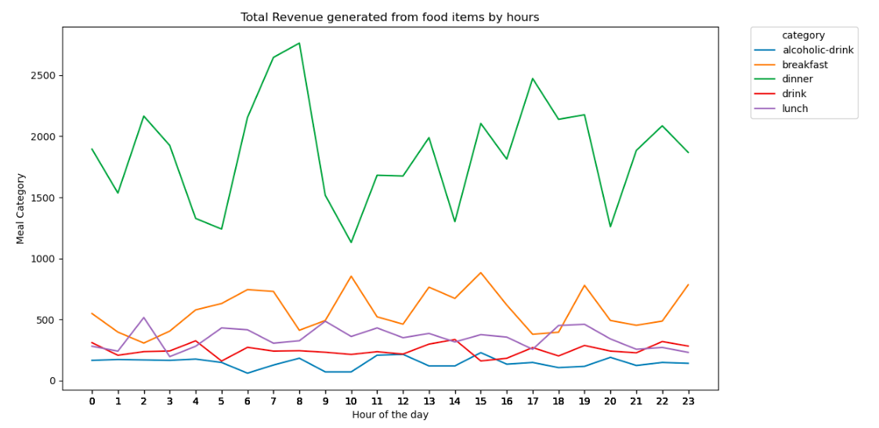
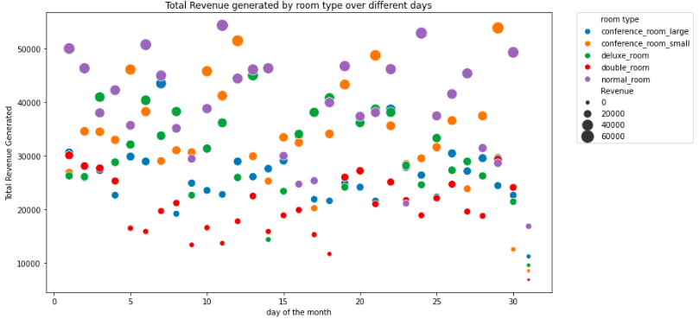
Dashboard : Analyzing Hotel Revenue by Booking and Food Orders

Slide 5
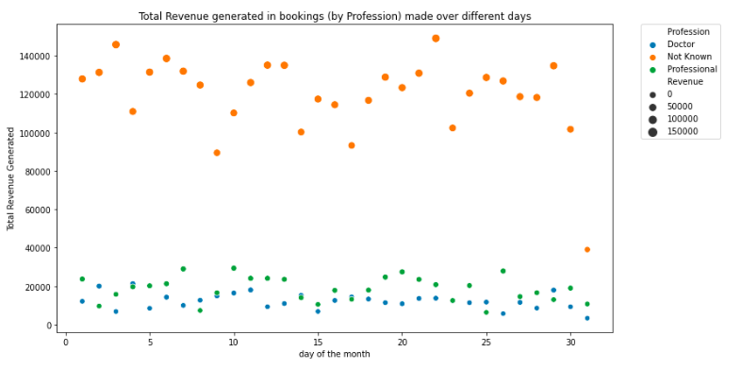
Actionable Insight 1: Low Revenue Indicator - Doctors and Professionals [PhD, DVM, DDS]
Insight : Doctors and Professionals are low Revenue contributors. Recommendation: Introduce Web Survey, to get feedback!

Slide 6
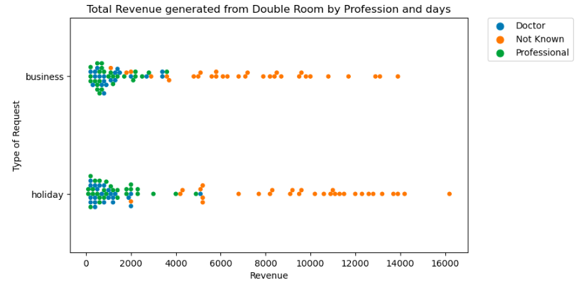
Actionable Insight 2: Low Revenue Indicator - Double Room
Insight : Double Rooms contribute to Revenue for Business and Holiday Request. Recommendation : Renovation of Double Rooms

Slide 7
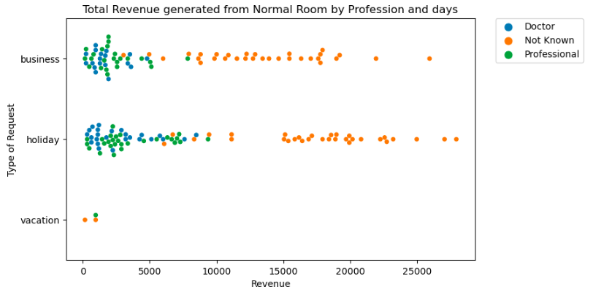
Actionable Insight 3: High Revenue Indicator - Normal Room
Insight : Normal Rooms highly contribute to Revenue for Business and Holiday Request. Recommendation : More benefits!!
Notes:
Business and Holidays are already highly contributing to Revenue. While conferences don’t contribute much on the revenue.

Slide 8
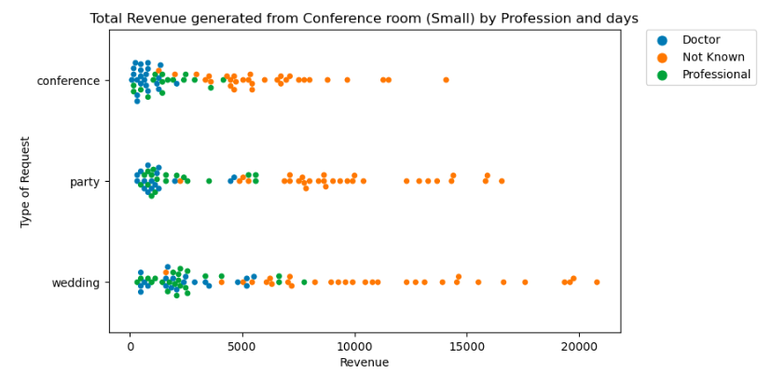
Actionable Insight 4: High Revenue Indicator - Small Conference Room
Insight : Small Conference Rooms highly contribute to Revenue, for Party and Wedding request.
Notes:
While conferences don’t contribute much on the revenue, Wedding and Party is a good indicator for Revenue.

Slide 9
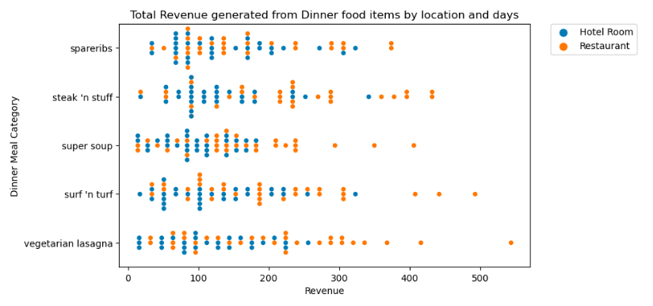
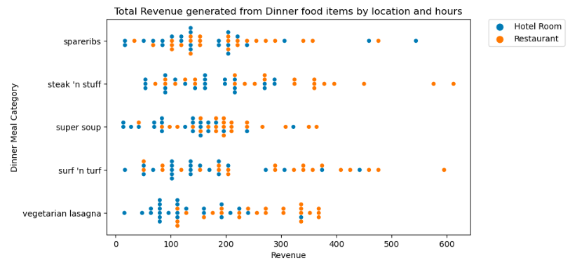
Actionable Insight 5: Best Selling Dinner! – Lasagna, Steak and Stuff and Surf n turf
Insight : Most orders made from Hotel Rooms are of lower dollar value, compared to orders made in Restaurants (Dine in)

Slide 10
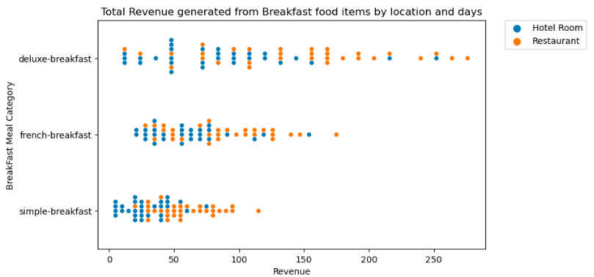
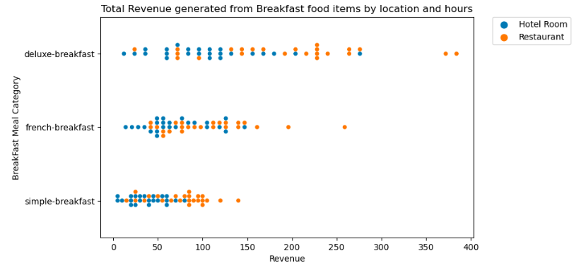
Actionable Insight 6: Best Selling Breakfast! - Deluxe Breakfast
Insight : Orders made from Hotel Rooms are lower dollar value, compared to Restaurants. Recommendation: French Breakfast!
Notes:
Recommendation Promotion on French Breakfast, can boost up the sales.

Slide 11
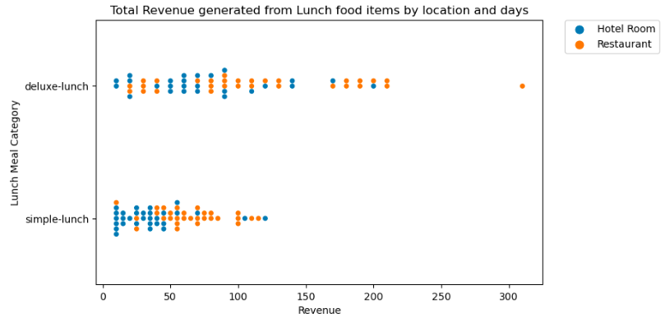
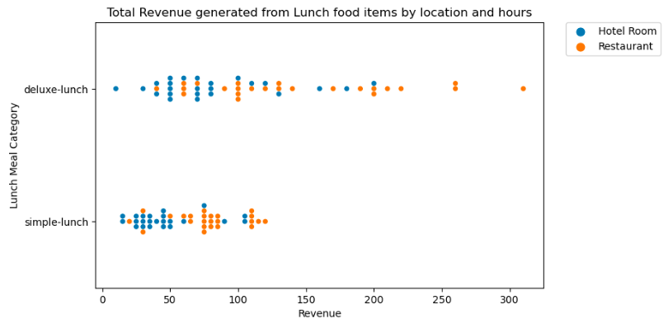
Actionable Insight 7: Low Revenue Indicator – Lunch Menu (Scope of Improvement)
Insight : Orders made from Hotel Rooms are lower dollar value, compared to Restaurants. Recommendation : More options required!
Notes:
I recommend the hotel to redesign their lunch menu to make it look similar to Dinner.

Slide 12
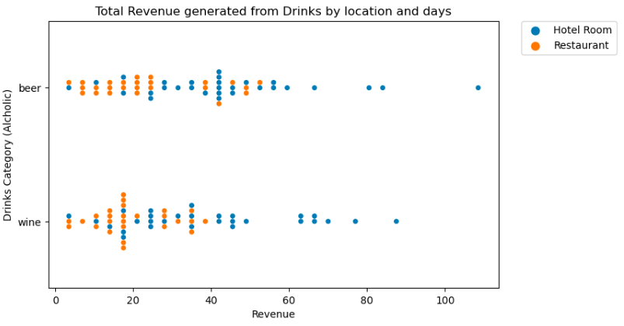
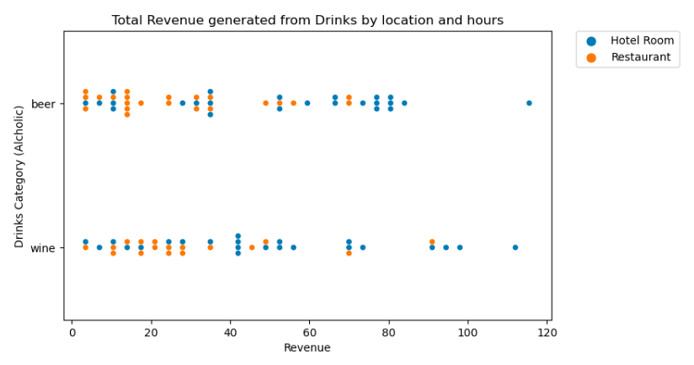
Actionable Insight 8: Low Revenue Indicator - Why customers order alcohol inside the room?
Insight : Orders made from Hotel Rooms are High dollar value, compared to Restaurants. Recommendation : Re-evaluate the Prices!
Notes:
Are the restaurants charging more for the drinks? It may be more expensive over the counter.

Slide 13
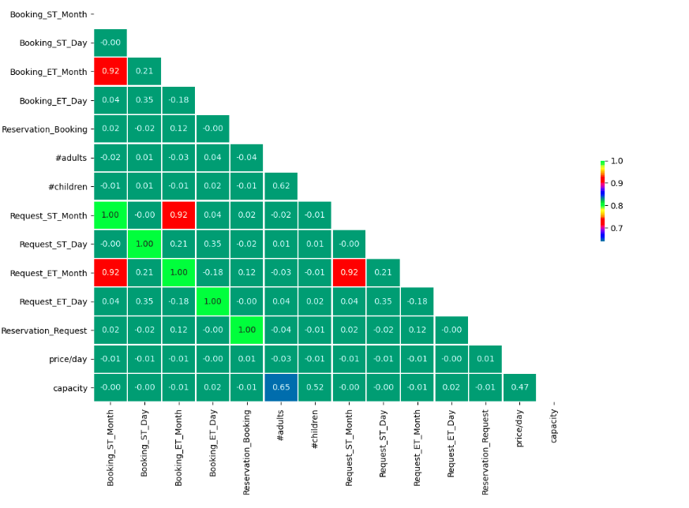
Appendix 1 : Correlation Matrix

Slide 14
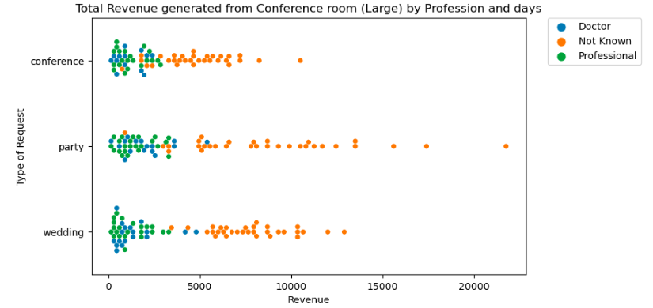
Appendix 2 : Large Conference Room
Insight : Large Conference Rooms contribute to Revenue for Conference, Party and Wedding Request.

Slide 15
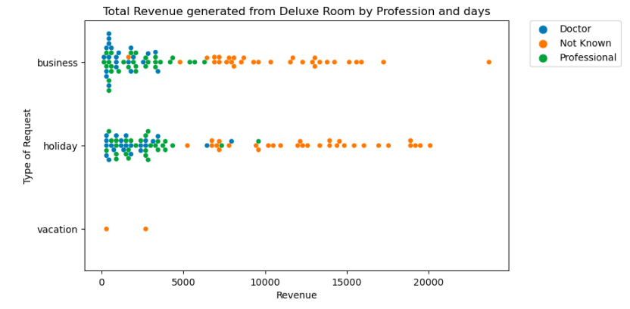
Appendix 3 : Deluxe Room
Insight : Deluxe Rooms contribute to Revenue for Business, Holiday and Vacation Request.

Slide 16
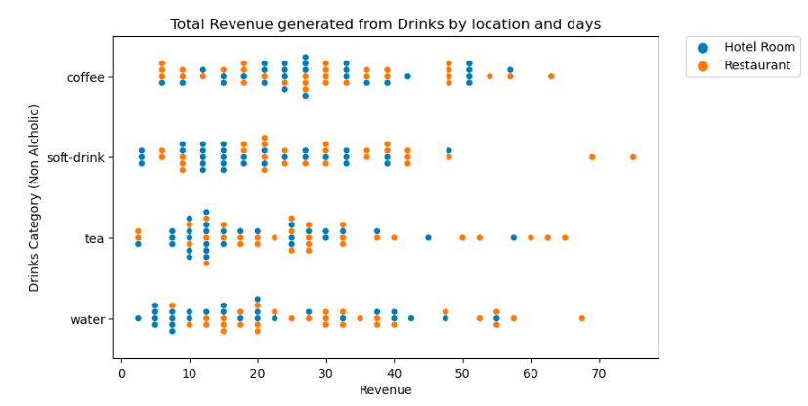
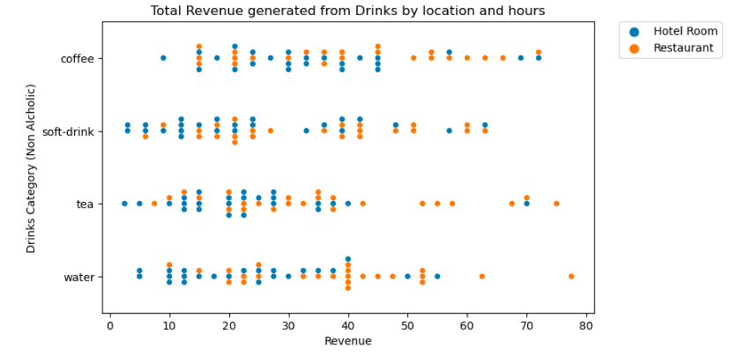
Appendix 1 : Drinks Insights (Non Alcoholic)
Insight : All drinks are equally famous. Orders made from Hotel Rooms are lower dollar value, compared to Restaurants.

Slide 17
Thank You

